Slide 1


Slide 2
Cable News Network (CNN) is a United States cable news channel founded in 1980 by Ted Turner.
Upon its launch, CNN was the first 24-hour cable news channel in the United States.
CNN-IBN is an English-language Indian television news channel.

Slide 3
Convolutional Neural Networks are are a special kind of multi-layer neural networks.
Like almost every other neural networks they are trained with a version of the back-propagation algorithm.
Where they differ is in the architecture.

Slide 4
In machine learning, CNN, or ConvNet is a class of deep, feed-forward artificial neural networks, most commonly applied to analyzing visual imagery.
CNNs use a variation of multilayer perceptrons designed to require minimal preprocessing.
They are also known as shift invariant or space invariant artificial neural networks (SIANN), based on their shared-weights architecture and translation invariance characteristics.

Slide 5
CNNs were inspired by biological processes in that the connectivity pattern between neurons resembles the organization of the animal visual cortex.
Individual cortical neurons respond to stimuli only in a restricted region of the visual field known as the receptive field.
The receptive fields of different neurons partially overlap such that they cover the entire visual field.

Slide 6
Use relatively little pre-processing compared to other image classification algorithms.
This means that the network learns the filters that in traditional algorithms were hand-engineered.
This independence from prior knowledge and human effort in feature design is a major advantage.

Slide 7
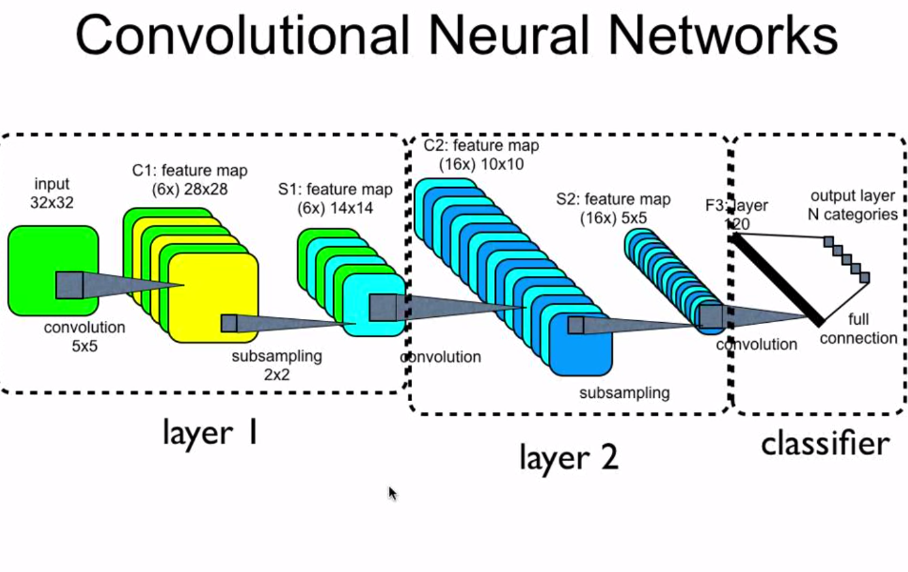

Slide 8
Historical Context and Motivation

Slide 9

In 1995, Yann LeCun and Yoshua Bengio introduced the concept of convolutional neural networks.
.`
Yann LeCun, Director of AI Research, Facebook
Founding Director of the NYU Center for Data Science
Professor of Computer Science, The Courant Institute of Mathematical Sciences, New York University
Famous paper: http://yann.lecun.com/exdb/publis/pdf/lecun-01a.pdf proceedings of IEEE

Slide 10
Y. LeCun, L. Bottou, Y. Bengio, and P. Haffner.
Gradient-based learning applied to document recognition
.Proceedings of the IEEE, November 1998.

Slide 11
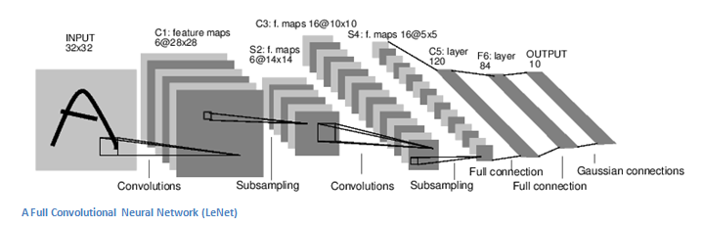
The LeNet Architecture (1990s)
LeNet was one of the very first convolutional neural networks which helped propel the field of Deep Learning.

Slide 12


Slide 13

Yoshua Bengio is Full Professor of the Department of Computer Science and Operations Research, Head of the Montreal Institute for Learning Algorithms (MILA)
Famous paper: https://www.iro.umontreal.ca/~lisa/pointeurs/TR1312.pdf

Slide 14
Learning Deep Architectures for AI
Yoshua Bengio Dept. IRO, Universit´e de Montr´eal C.P. 6128, Montreal, Qc, H3C 3J7, Canada Yoshua.Bengio@umontreal.ca http://www.iro.umontreal.ca/∼bengioy Technical Report 1312
Deep learning (DL) is a family of machine learning methods that has gained considerable attention in the scientific community, breaking benchmark records in areas such as speech and visual recognition.

Slide 15
DL differs from conventional machine learning methods by virtue of its ability to learn the optimal representation from the raw data through consecutive nonlinear transformations, achieving increasingly higher levels of abstraction and complexity.

Slide 16
Since CNNs require large computational power, they were not used much for many years till in 2012 when Alex Krizhevsky, Geoffrey Hinton, and Ilya Sutskever introduced their famous AlexNet which won the famous Image Classification challenge, on 1000 class ImageNet having a top 5 error rate of 15% (the next one being 26.5%).
Every single winner of ImageNet after 2012 used CNNs, the latest one being Microsoft’s ResNets which achieved a top 5 error of 3.6% which is better than the human level performance on the same task.

Slide 17
AlexNet is the name of a CNN, invented by Alex Krizhevsky, Ilya Sutskever and Geoffrey Hinton.
AlexNet has had a large impact on the field of machine learning, specifically in the application of deep learning to machine vision. As of 2018 it has been cited over 25,000 times.
The original paper's primary result was that the depth of the model was essential for its high performance, which was computationally expensive, but made feasible due to the utilization of GPUs during training

Slide 18

I’m a staff research scientist at Google Brain, where I lead a research group studying adversarial techniques in AI (adversarial examples, generative adversarial networks, etc.). Together with Yoshua Bengio and Aaron Courville, I wrote the deep learning textbook (www.deeplearningbook.org

Slide 19


Slide 20
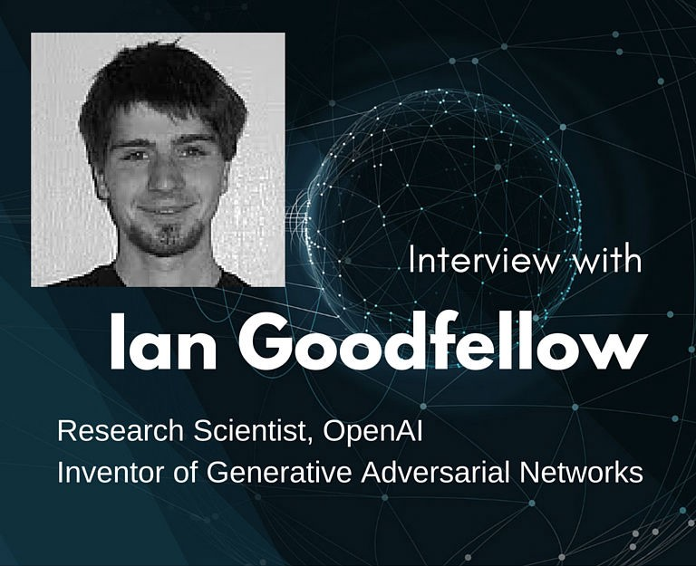

Slide 21
In 2014 Ian Goodfellow came up with a genius idea to let two adversary networks play a game whereby one model, the generator, tries to generate fake data to fool the second model, the discriminator, into “thinking” that the fake data is real while the discriminator tries it's best to tell the fake from the real.
That approach has been termed the Generative Adversarial Network (GAN).
There are now many variants of GANs out there.

Slide 22
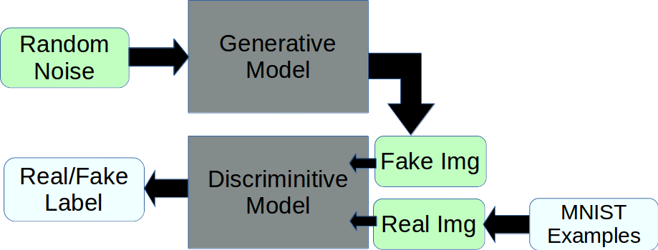

Slide 23
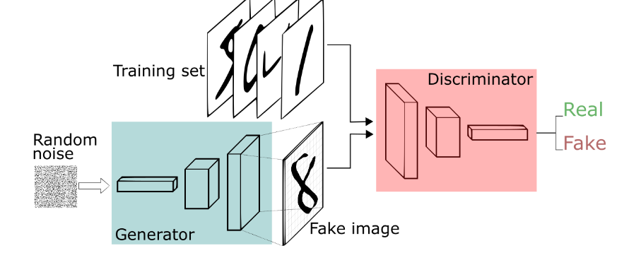
One neural network, called the generator, generates new data instances, while the other, the discriminator, evaluates them for authenticity; i.e. the discriminator decides whether each instance of data it reviews belongs to the actual training dataset or not.

Slide 24
6 most seminal contributions to research in neural networks in the last 8 years?
Generative Adversarial Networks
Auto-Encoding Variational Bayes
AlexNet
TensorFlow: A system for large-scale machine learning
Sequence to Sequence Learning with Neural Networks
Playing Atari with Deep Reinforcement Learning

Slide 25
What are Convolutional Neural Networks and how they work???
A convolutional neural network is a specialized kind of neural network for processing the data which has the grid like topology.
Convolutional Neural Networks are MLPs with a special structure.
Examples of such data can be images which can be considered as a 2D(grayscale) or 3D(coloured RGB) grid of pixels, time series data which can be thought of as the 1D grid taking samples at regular time intervals
Definitions taken from the Deep Learning book by Ian Goodfellow

Slide 26
Medical practitioners and researchers are now using images defined by voxels and 3-D software to view X-rays, CT scans, and magnetic resonance imaging (MRI) scans from different angles, effectively to see the inside of the body from outside.
Geologists can create 3-D views of earth profiles based on sound echoes.
Engineers can view complex machinery and material structures to look for weaknesses.

Slide 27
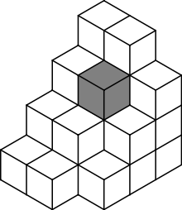
A voxel (volumetric pixel or Volumetric Picture Element) is a volume element, representing a value on a regular grid in three dimensional space.
This is analogous to a pixel, which represents 2D image data in a bitmap (which is sometimes referred to as a pixmap).
3D data for medical images which might be considered as 3D(grayscale) or 4D(coloured) grid of voxels.

Slide 28
Apart from Image Classification, CNNs are now also used for many other applications like:
Object Localization and Object Detection
Image Segmentation
Image Captioning
Style Transfer
Video Analysis
Medical Diagnosis
Image Coloring
Super Resolution
Speech Recognition
Document Classification
Self Driving Cars
NLP
….

Slide 29
NATURAL LANGUAGE PROCESSING (NLP) is one of the upcoming applications of AI.
The goal of the Natural Language Processing is to design and build software that will analyze, understand, and generate languages that humans use naturally, so that eventually you will be able to address your computer as though you were addressing another person.

Slide 30
Natural Language Processing is the use of computers to process written and spoken language for some practical, useful, purpose like translation, database access, information retrieval, text categorization, extracting data from text, semantic Parsing[task of converting a natural language utterance to a logical form: a machine-understandable representation of its meaning], search query retrieval, sentence modeling, classification, prediction and other traditional NLP tasks.
Some basic systems CHATBOTS are already developed like ELIZA, INTELLISHRINK, AMALGAM,ALEXA etc

Slide 31
Commonly used architectures
Convolutional Neural Nets (CNNs) - for images, and lately NLP.
Recurrent Neural Nets (RNNs) - including LSTMs and GRUs for temporal data, including NLP, video, time series, speech.
Generative Adversarial Networks (GANs) - for capturing some domain, such as an artistic style.

Slide 32
Layers used to build ConvNets
Three main types of layers to build ConvNet architectures:
Convolutional Layer
Pooling (Sub-sampling) Layer
Fully-Connected (Classification) Layer

Slide 33

ARCHITECTURE (VGG 16)

Slide 35
The name “convolutional neural network” comes from the use of the mathematical operation convolution in the network.
Convolutional Neural Networks are simply neural networks that use convolution in place of general matrix multiplication in at least one of its layers.
The convolutional layer can be thought of as the eyes of the CNN.

Slide 36
The neurons in this layer look for specific features. If they find the features they are looking for, they produce a high activation.
The primary purpose of Convolution in case of a ConvNet is to extract features from the input image
Convolution preserves the spatial relationship between pixels by learning image features using small squares of input data.

Slide 37
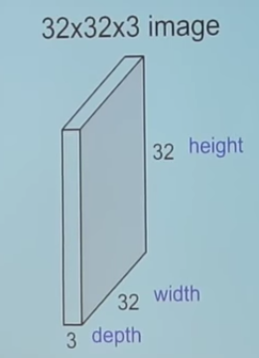
CNNs operate over Volumes !
What do we mean by this?
Unlike neural networks, where the input is a vector, here the input is a multi-channeled image (3 channeled in this case).

Slide 38
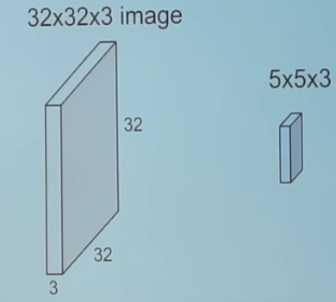
We take the 5*5*3 filter and slide it over the complete image and along the way take the dot product between the filter and chunks of the input image.

Slide 39
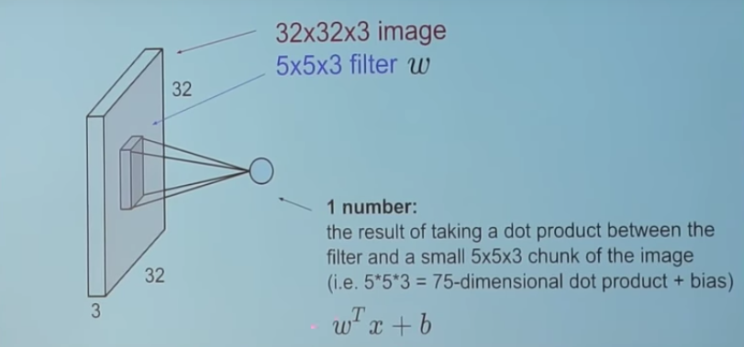
For every dot product taken, the result is a scalar.
So, what happens when we convolve the complete image with the filter?

Slide 40
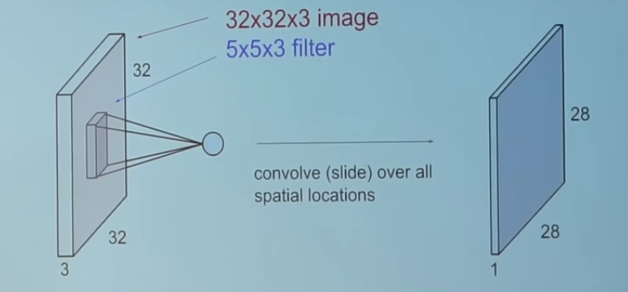
There are 28*28 unique positions where the filter can be put on the image

Slide 41
A simple ConvNet for CIFAR-10 classification could have the architecture
[INPUT[32x32x3] - CONV [32x32x12] - RELU [32x32x12] - POOL [16x16x12] – FC[3072x1]- OL[10x1].
INPUT [32x32x3] will hold the raw pixel values of the image, in this case an image of width 32, height 32, and with three color channels R,G,B.
CONV layer will compute the output of neurons that are connected to local regions in the input, each computing a dot product between their weights and a small region they are connected to in the input volume.
This may result in volume such as [32x32x12] if 12 filters are used.

Slide 42
RELU layer will apply an element-wise activation function, such as the max(0,x) thresholding at zero. This leaves the size of the volume unchanged ([32x32x12]).
POOL layer will perform a down-sampling operation along the spatial dimensions (width, height), resulting in volume such as [16x16x12].
FC (i.e. fully-connected) and output layer will compute the class scores, resulting in volume of size [1x1x10], where each of the 10 numbers correspond to a class score, such as among the 10 categories of CIFAR-10

Slide 43
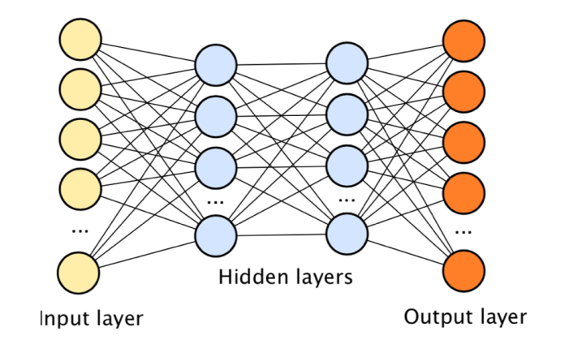
MLP

Slide 44
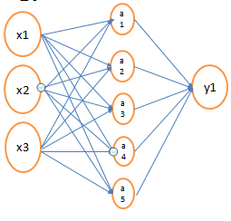
Number of Parameters ??

Slide 45
In general, if we have ‘n’ dimensional data with one hidden layer having ‘h’ hidden units and one output, the total number of parameters required will be:
Hence as the dimensionality of the data increases the number of parameters in the model also increases.

Slide 46
(a)Consider a neural network which classifies the Cat and non cat images, having inputs as images of dimensions 224x224x3, 1 hidden layer having 512 hidden units and one output giving 1 for a cat image and 0 otherwise. Estimate the number of parameters in this model. Assume no biases are used in the model.
(b) What about the number of parameters when images are of dimensions 512x512x3.

Slide 47
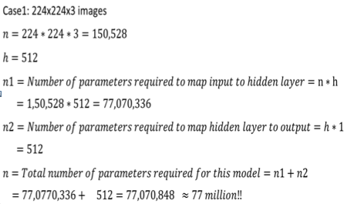
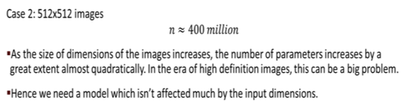

Slide 48
Problems with traditional Neural Network Models
Fully connected Networks or Multi Layer Perceptron Model mainly suffers from two big limitations:
Huge number of parameters (weights) are required when inputs are high dimensional.
Does not handle the spatial and temporal aspect of the data.
CNNs handle both of these limitations very well and hence are well suitable for data like images, audios, videos, text files etc. which are both very high dimensional as well as consists of spatial or temporal features in the data.

Slide 49
Benefits of using CNNs
They use fewer parameters (weights) to learn than a fully connected network.
They are designed to be invariant to object position and distortion in the scene.
They automatically learn and generalize features from the input domain.
https://machinelearningmastery.com/crash-course-convolutional-neural-networks/

Slide 50
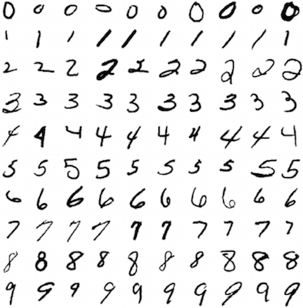
Two established machine learning benchmarks:
MNIST (Modified National Institute of Standards and Technology )Databasee for classification of handwritten digits) and
MNIST

Slide 51
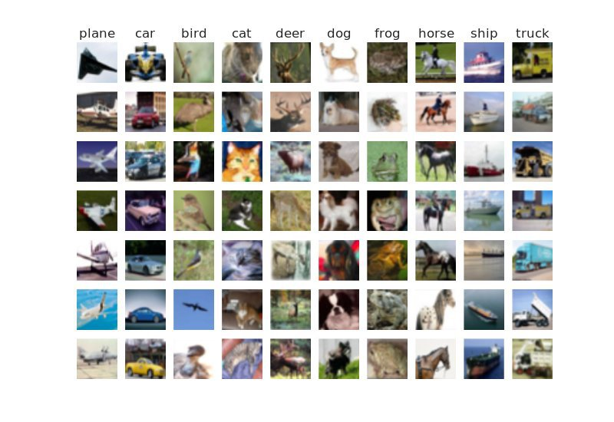
CIFAR-10 (classification of small images across 10 distinct classes – airplane, automobile, bird, cat, deer, dog, frog, horse, ship & truck).

Slide 52
Regular Neural Nets don’t scale well to full images.
In CNN(CIFAR-10), images are only of size 32x32x3 (32 wide, 32 high, 3 color channels), so a single fully-connected neuron in a first hidden layer of a regular Neural Network would have 32*32*3 = 3072 weights.

Slide 53
Colored Images are represented as 3 dimensional (one for height, one for width and one for the channel i.e RGB) arrays in computer memory.
Since the input to the Fully Connected Neural Networks are 1 dimensional arrays, we first flatten the image into a single big vector, for eg. a 200x200x3 image will be flattened to a 200x200x3 = 120000 dimensional vector.
Clearly, this full connectivity is wasteful and the huge number of parameters would quickly lead to overfitting.

Slide 54
Benefits of using ReLU
The constant gradient of ReLUs results in faster learning. (no. of epochs)
Deep convolutional neural networks with ReLUs train several times faster than their equivalents with tanh units
Less computation
Results in less time for training

Slide 55
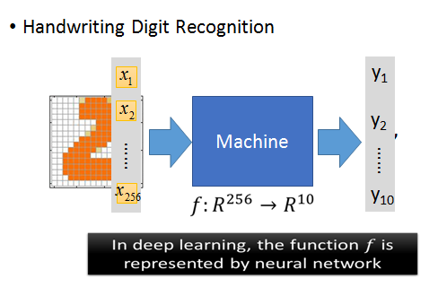
Softmax at output layer

Slide 56
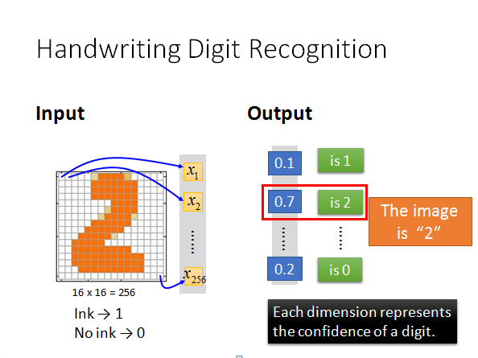
Softmax at output layer

Slide 57


Slide 58
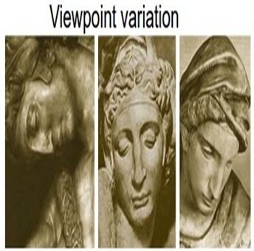
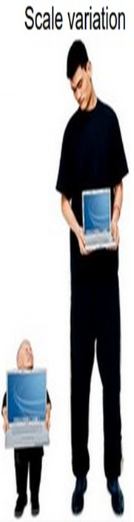
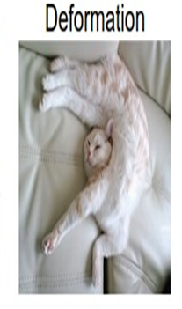
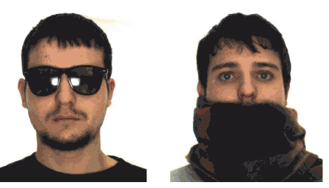
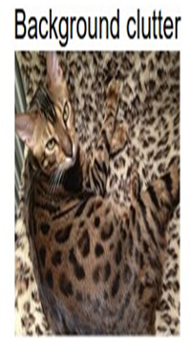
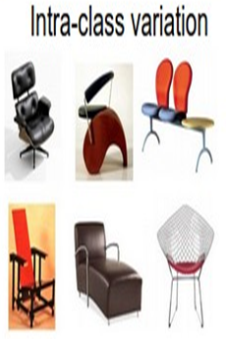
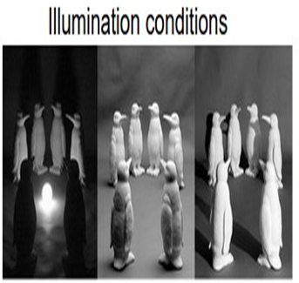

Slide 59
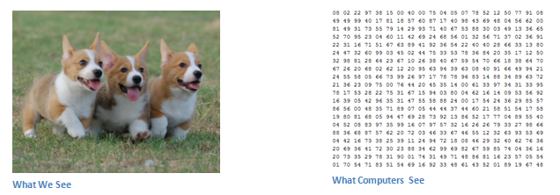
Input and Output
When a computer sees an image (takes an image as input), it will see an array of pixel values.
Depending on the resolution and size of the image, in this case it will see a 32 x 32 x 3 array of numbers (The 3 refers to RGB channel)

Slide 60
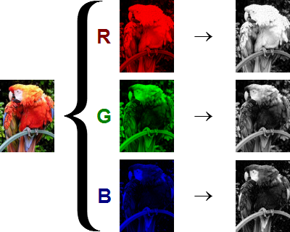
Channel is a conventional term used to refer to a certain component of an image.
An image from a standard digital camera will have three channels – red, green and blue

Slide 61
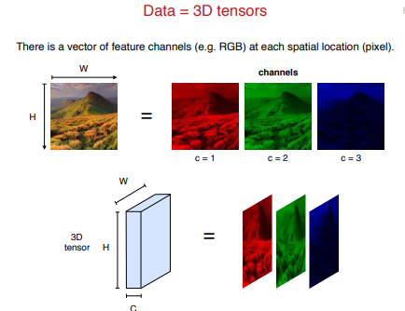

Slide 62
How many possible colors ??
The red, green and blue use 8 bits each, which have integer values from 0 to 255. This makes 256*256*256=1,67,77,216 possible colors.
In a binary image a pixel can only take on either the value 0 or the value 255.
In contrast, in a greyscale or colour image a pixel can take on any value between 0 and 255.
In a colour image the grey level of each pixel can be calculated using the following formula:
Grey level = 0.299 * red component + 0.587 * green component + 0.114 * blue component

Slide 63
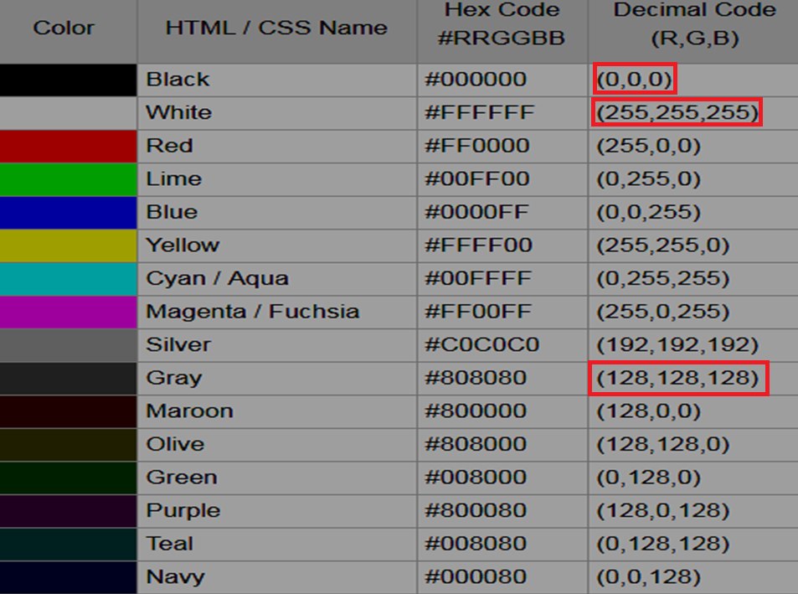

Slide 64
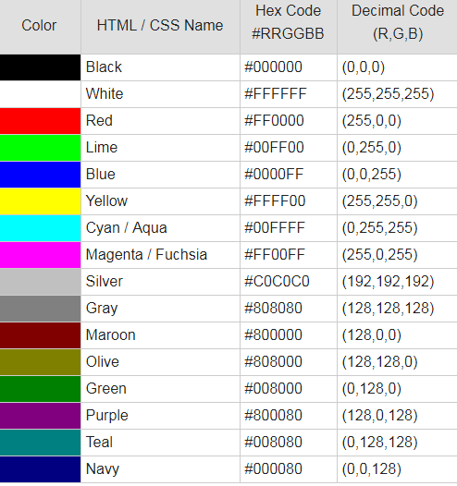

Slide 65

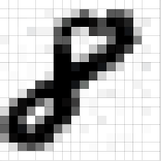
A grayscale image, on the other hand, has just one channel.

Slide 66
The very basic way to create a grey scale image is to set the colours Red, Green, and Blue to the same value.
Binarization is an operation that converts a greyscale image into a binary image.
binarization process will be done by using thersholding method by neural network toolbox. Here thersholding refers to setting of all the grey levels below a certain level to zero or above a certain level to a maximum brightness level.
Each pixel is assigned a new value (1b or 0b).

Slide 67
Databases
Modified National Institute of Standards and Technology Database(MNIST Database)
ImageNet
Face Evaluation Recognition Technology(FERET)

Slide 68
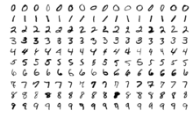
MNIST Database
The MNIST database is a large database of handwritten digits that is commonly used for training various image processing systems.
The MNIST database contains 60,000 training images and 10,000 testing images.

Slide 69
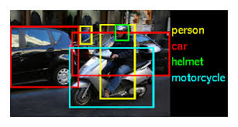
ImageNet
The ImageNet project is a large visual database designed for use in visual object recognition software research
Over 14 million URLs of images have been hand-annotated by ImageNet to indicate what objects are pictured and in at least one million of the images, bounding boxes are also provided.
ImageNet contains over 20 thousand categories, such as "balloon" or "strawberry", contains several hundred images.

Slide 70
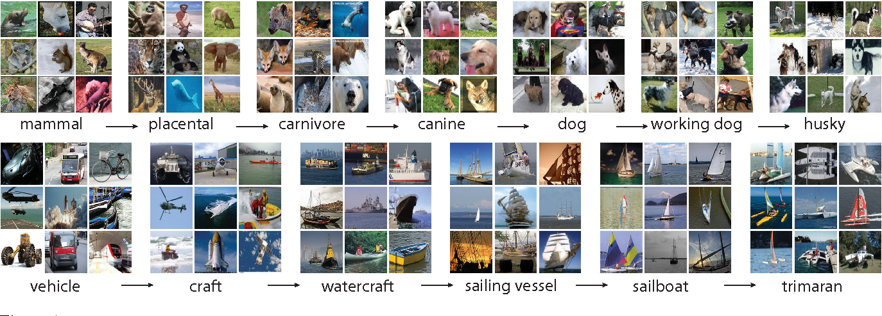

Slide 71
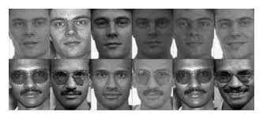
FERET
The FERET database is a dataset used for facial recognition system evaluation.
The Face Recognition Technology (FERET) program is managed by the Defense Advanced Research Projects Agency (DARPA) and the National Institute of Standards and Technology (NIST)

Slide 72
CIFAR-10 (Canadian Institute For Advanced Research)dataset classification is a common benchmark problem in machine learning.
The problem is to classify RGB 32x32 pixel images across 10 categories:
airplane, automobile, bird, cat, deer, dog, frog, horse, ship, and truck.

Slide 73
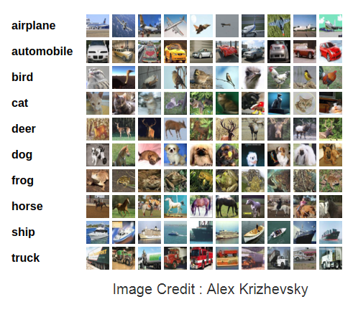
The CIFAR10 comes bundled with Keras. It has 50,000 training images and 10,000 test images.

Slide 74
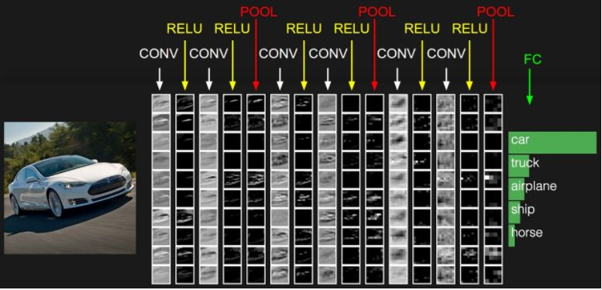
The initial volume stores the raw image pixels (left) and the last volume stores the class scores (right)

Slide 75
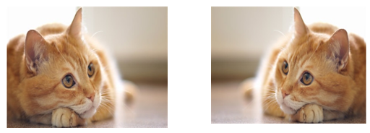
Problems with traditional Neural Network Models: Spatial Aspect of data
Both are the same images, the second image is obtained by flipping the first image horizontally.
Although the subject of the images is same but the order of pixels have completely changed now

Slide 76
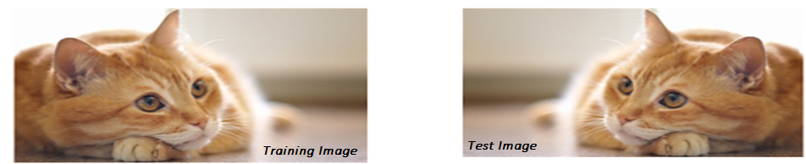
in fully connected neural networks we learn the weights corresponding to each pixel in the image, the order in which the pixels are present in the image matters.
If we trained our neural network with images of cats with its face in the left hand side, then neurons of the network will fire when they see the cat face at the left.
At the test time if we input an inverted image, the pixels on the left won’t correspond to a cat face, instead will correspond to the background and hence we might get different results.

Slide 77
What other operations can change the order of the pixels ???
shifting the image by some amount, cropping the image or any other operations which change the order of the pixels would result in the same problem.
Need a neural network model which is not affected by the order in which the pixels are processed, but instead looks for the presence of certain pixels in the image.
Convolutional Neural Networks provide a very efficient solution to this problem.

Slide 78
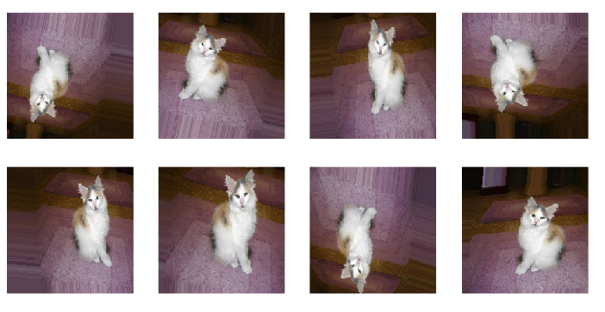
Why generate these images for training..
to recognize cat??

Slide 79
One of the major reasons for overfitting is that you don’t have enough data to train your network.
Apart from Regularization, another very effective way to counter Overfitting is Data Augmentation.
It is the process of artificially creating more images from the images you already have by changing the size, orientation etc of the image.
It can be a tedious task but fortunately, this can be done in Keras using the ImageDataGenerator instance.

Slide 80
from keras.preprocessing.image import ImageDataGenerator
ImageDataGenerator(
rotation_range=10.,
width_shift_range=0.1,
height_shift_range=0.1,
shear_range=0.,
zoom_range=.1.,
horizontal_flip=True,
vertical_flip=True)
In the above code, the ImageDataGenerator for data augmentation includes
rotation of the image,
shifting the image left/right/top/bottom by some amount, flip the image horizontally or vertically,
shear or zoom the image etc.

Slide 81
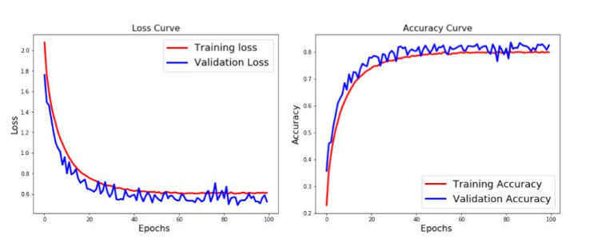
COMMENTS/OBSERVATIONS
The test accuracy is greater than training accuracy. This means that the model has generalized very well.
This comes from the fact that the model has been trained on much worse data ( for example – flipped images ), so it is finding the normal test data easier to classify!!

Slide 82
“Horizontal flips and 180 rotation are not appropriate ways of augmenting data sets for optical character recognition tasks” Why??
Difference between “b” & “”d”, “6” & “9” would not be recognizable

Slide 83
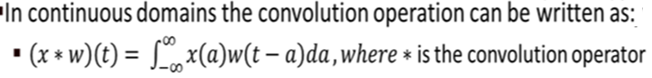
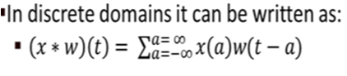
In CNN terminology, the first argument of the operation (x) is called the Input and second argument (w) is known as FILTER or KERNEL

Slide 84
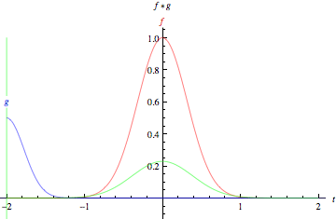
Convolution operator can be thought of as taking a big window as the input and a Filter operated (dot product) on portion of window, and then slide filter on new portion of input , output expresses the amount of overlap of one function as it is shifted over other function

Slide 85
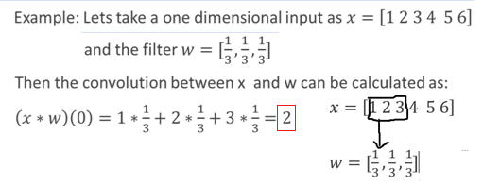
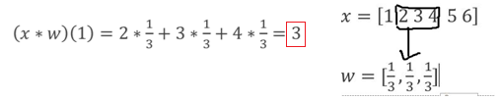

Slide 86
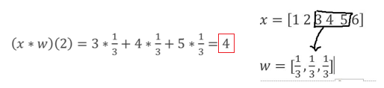
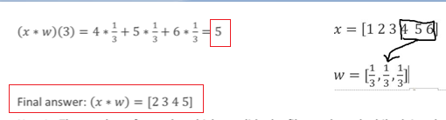

Slide 87
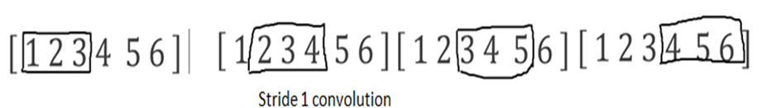
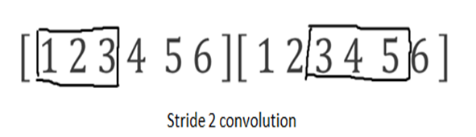


Slide 88
There are many filters doing different tasks for us like edge filters, bar filters.
Major filter banks are:
The Leung-Malik (LM) Filter Bank
The Schmid (S) Filter Bank
The Maximum Response (MR) Filter Banks
Gabor Filters
The filters are nothing more than weights, so they do get updated.
Filters are chosen only in the sense of specifying how many filters you want at each level of the CNN.
Backprop will determine the weights and hence the filters

Slide 89


This filter finds vertical edges in the images by convolving
This filter finds horizontal edges
But we don’t know which filters to use for extracting the features from the image. Hence we learn those filters or kernels, i.e. we initialize the filters randomly and learn the values of these filters by optimizing the loss or error function.

Slide 90

W= [(4-2)/1+ 1 ] =3
H= [(3-2)/1+ 1 ] =2

Slide 91


The reason you get a
4 x 4 array is that
there are 16 different locations that a 3 x3 filter can fit on a 6 x 6 input image

Slide 92


Slide 93


Slide 94

Convolution is locally shift invariant, for many(not all) different combinations of how the nine numbers in upper 3 x 3 matrix are placed, the convolved result is 29.
This invariant property plays a crucial role in vision problem because in the ideal case , the recognition result should not be changed due to shift or rotation of features
https://arxiv.org/pdf/1702.07800.pdf

Slide 95



Slide 96



Consider a 5 x 5 image and 3 x 3 matrix as shown below :
In CNN terminology, the 3×3 matrix is called a ‘filter‘ or ‘kernel’ or ‘feature detector’ .
INPUT IMAGE: 5x5
FILTER/KERNEL: 3x3
STRIDE :1
Convolved FEATURE MAP :3x3
slide the orange matrix over our original image (green) by 1 pixel (also called ‘stride’) and for every position

Slide 97
Consider an simple image matrix of 5 x 5 and filter of 3 x 3.
To convolve, consider 1st 3 rows and 3 columns.
1 | 0 | 0 | 0 | 1
1 | 1 | 0 | 1 | 0
1 | 0 | 1 | 1 | 1
0 | 0 | 1 | 1 | 0
0 | 1 | 0 | 0 | 1
0 | 1 | 0
1 | 1 | 1
0 | 1 | 0
1 | 0 | 0 | 0 | 1
1 | 1 | 0 | 1 | 0
1 | 0 | 1 | 1 | 1
0 | 0 | 1 | 1 | 0
0 | 1 | 0 | 0 | 1
1 | 0 | 0
1 | 1 | 0
1 | 0 | 1
0 | 1 | 0
1 | 1 | 1
0 | 1 | 0
x
Image part
filter
Elementwise multiplication
I1= 1 × 0 +0 × 1 + 0 × 0+ 1 × 1 + 1 × 1 + 1 × 0 + 1 × 0 + 0 × 1 + 1× 0 =2

Slide 98
Shifting the image part
I2=0×0+0×1+0×0+1×1+0×1+1×1+0×0+1×1+1×0 =3
1 | 0 | 0 | 0 | 1
1 | 1 | 0 | 1 | 0
1 | 0 | 1 | 1 | 1
0 | 0 | 1 | 1 | 0
0 | 1 | 0 | 0 | 1
0 | 1 | 0
1 | 1 | 1
0 | 1 | 0
0 | 0 | 0
1 | 0 | 1
0 | 1 | 1
x
1 | 0 | 0 | 0 | 1
1 | 1 | 0 | 1 | 0
1 | 0 | 1 | 1 | 1
0 | 0 | 1 | 1 | 0
0 | 1 | 0 | 0 | 1
0 | 0 | 1
0 | 1 | 0
1 | 1 | 1
0 | 1 | 0
1 | 1 | 1
0 | 1 | 0
x
I3=0×0+0×1+1×0+0×1+1×1+0×1+1×0+1×1+1×0 =2

Slide 99
I4=1×0+1×1+0×0+1×1+0×1+1×1+0×0+0×1+1×0=3
I5=1×0+0×1+1×0+0×1+1×1+1×1+0×0+1×1+1×0=3
1 | 0 | 0 | 0 | 1
1 | 1 | 0 | 1 | 0
1 | 0 | 1 | 1 | 1
0 | 0 | 1 | 1 | 0
0 | 1 | 0 | 0 | 1
1 | 1 | 0
1 | 0 | 1
0 | 0 | 1
0 | 1 | 0
1 | 1 | 1
0 | 1 | 0
x
1 | 0 | 0 | 0 | 1
1 | 1 | 0 | 1 | 0
1 | 0 | 1 | 1 | 1
0 | 0 | 1 | 1 | 0
0 | 1 | 0 | 0 | 1
1 | 0 | 1
0 | 1 | 1
0 | 1 | 1
0 | 1 | 0
1 | 1 | 1
0 | 1 | 0
x

Slide 100
1 | 0 | 0 | 0 | 1
1 | 1 | 0 | 1 | 0
1 | 0 | 1 | 1 | 1
0 | 0 | 1 | 1 | 0
0 | 1 | 0 | 0 | 1
0 | 1 | 0
1 | 1 | 1
1 | 1 | 0
0 | 1 | 0
1 | 1 | 1
0 | 1 | 0
x
I6=0×0+1×1+0×0+1×1+1×1+1×1+1×0+1×1+1×0 =5
1 | 0 | 0 | 0 | 1
1 | 1 | 0 | 1 | 0
1 | 0 | 1 | 1 | 1
0 | 0 | 1 | 1 | 0
0 | 1 | 0 | 0 | 1
1 | 0 | 1
0 | 0 | 1
0 | 1 | 0
0 | 1 | 0
1 | 1 | 1
0 | 1 | 0
x
I7=1×0+0×1+1×0+0×1+0×1+1×1+0×0+1×1+0×0 =2

Slide 101
I8=0×0+1×1+1×0+0×1+1×1+1×1+1×0+0×1+0×0=3
I9=1×0+1×1+1×0+1×1+1×1+0×1+0×1+1×1+1×0 =4
1 | 0 | 0 | 0 | 1
1 | 1 | 0 | 1 | 0
1 | 0 | 1 | 1 | 1
0 | 0 | 1 | 1 | 0
0 | 1 | 0 | 0 | 1
0 | 1 | 1
0 | 1 | 1
1 | 0 | 0
0 | 1 | 0
1 | 1 | 1
0 | 1 | 0
x
1 | 0 | 0 | 0 | 1
1 | 1 | 0 | 1 | 0
1 | 0 | 1 | 1 | 1
0 | 0 | 1 | 1 | 0
0 | 1 | 0 | 0 | 1
1 | 1 | 1
1 | 1 | 0
0 | 1 | 1
0 | 1 | 0
1 | 1 | 1
0 | 1 | 0
x

Slide 102

2 | 3 | 2
3 | 3 | 5
2 | 3 | 4
‘Convolved Feature’ or ‘Activation Map’ or the ‘Feature Map‘.
It is evident that different values of the filter matrix will produce different Feature Maps for the same input image.

Slide 103

input is a 32 x 32 x 3 array of pixel values.
The best way to explain a conv layer is to imagine a flashlight that is shining over the top left of the image and let’s say that the light this flashlight shines covers a 5 x 5 area.
Imagine this flashlight sliding across all the areas of the input image

Slide 104

In the output volume,
2 nd depth slice is produced by performing a convolution between 2 nd filter and input volume
an input volume of 7x7x3 and we are convolving it with 2 filters of 3x3x3.

Slide 105
As in the case of 2D convolution dot products are taken between the kernels and the portion of the input, since now there are multiple channels, we take dot products of the corresponding channels of the image portion and the filter and add the values obtained from each channel to get the value of output at a single location.
Hence the depth of the output after performing a single convolution will always be 1, in other words we will obtain a 2d matrix after convolution
In this case we have performed 2 convolutions on the image using 2 filters. The output of each convolution will be a 2d matrix, and we have stacked both of these matrices along the depth axis, hence we have the output size as 3x3x2.

Slide 106

[2+2]+[-1+2-1+2]+[1+1-2]+1(bias)=7

Slide 107

[1]+ [ 2+1] +[1+2] + 1(bias)= 8

Slide 108

[-2-2]+ [ -2+1-2] +[2-1-1-1] + 0(bias)= -8

Slide 109
Number of parameters/weights :??
54
[FxFxD₁ ]xK
[(3x3)x3]x2=54

Slide 110
An important feature of a convolutional neural network is Parameter Sharing.
Instead of learning parameters for each value or neuron in the input as in the case of regular neural nets, we share the parameters along the small portions of the input.
for a single 2d depth slice of the output all neurons will use the same weights.

Slide 111
Example 1. For example, suppose that the input volume has size [32x32x3], (e.g. an RGB CIFAR-10 image). If the receptive field (or the filter size) is 5x5, then each neuron in the Conv Layer will have weights to a [5x5x3] region in the input volume, for a total of
5*5*3 = 75 weights (and +1 bias parameter).
Notice that the extent of the connectivity along the depth axis must be 3, since this is the depth of the input volume.
Example 2. Suppose an input volume had size [16x16x20]. Then using an example receptive field size of 3x3, every neuron in the Conv Layer would now have a total of
3*3*20 = 180 connections to the input volume.
Notice that, again, the connectivity is local in space (e.g. 3x3), but full along the input depth (20).

Slide 112

Stride and Padding
In the example given below, the filter convolves around the input volume by shifting one unit at a time
The amount by which the filter shifts is the stride.

Slide 113

F is Filter size (spatial dimension)
P is Padding
S is Stride
W is input height/length
O is the output height/length

Slide 114

If stride is 2
The receptive field is shifting by 2 units now and the output volume shrinks as well.
Normally, stride value is increased if you want receptive fields to overlap less and want smaller spatial dimensions.

Slide 115
We can compute the spatial size of the output volume as a function of the input volume size (W), the receptive field size of the Conv Layer neurons (F/K), the stride with which they are applied (S), and the amount of zero padding used (P) on the border.
formula for calculating how many neurons “fit” is given by
For example for a 7x7 input and a 3x3 filter with stride 1 and pad 0 we would get a 5x5 output.
for a 7x7 input and a 3x3 filter with stride 2 we would get a 3x3 output.

Slide 116


What is Stride ? S=1

Slide 117


Use of zero-padding.
In the example above input dimension was 5 and the output dimension was also 5. This worked out so because our receptive fields were 3 and we used zero padding of 1.
If there was no zero-padding used, then the output volume would have had spatial dimension of only 3, because that it is how many neurons would have “fit” across the original input.
setting zero padding to be P=(F−1)/2 when the stride is S=1 ensures that the input volume and output volume will have the same size spatially.

Slide 118



The neuron weights are in this example [1,0,-1] (shown on very right), and its bias is zero. These weights are shared across all yellow neurons
[Parameter sharing]
What is Stride ? S=2

Slide 119
The Krizhevsky et al. architecture that won the ImageNet challenge in 2012 accepted images of size [227x227x3].
On the first Convolutional Layer, it used neurons with receptive field size F=11, stride S=4 and no zero padding P=0, No. of Filters =96.
Since [(227 - 11)/4] + 1 = 55, and since the Conv layer had a depth of K=96, the Conv layer output volume had size [55x55x96].
Each of the 55*55*96 neurons in this volume was connected to a region of size [11x11x3] in the input volume. Moreover, all 96 neurons in each depth column are connected to the same [11x11x3] region of the input, but of course with different weights[ different filters]. Number of weights to be trained 11x11x96=[Parameter sharing]

Slide 120
Stride is normally set in a way so that the output volume is an integer and not a fraction.
spatial dimensions decrease when we apply convolution. As we keep applying conv layers, the size of the volume will decrease faster.
In the early layers of our network, we want to preserve as much information about the original input volume so that we can extract those low level features.
If we want to apply convolutional layer and want to keep our volume same then we apply padding
Zero padding pads the input volume with zeros around the border

Slide 121

Consider an example 32(W) x 32 x 3, with stride(S=1), Filter size (5(=K)x5) and after zero padding(P=0) we get:
Without padding it would have been 28 x 28 x 3 .

Slide 122
With Stride of 1,Filter size F, output size would be of same size as input, with zero padding of
Input Size : 32 x 32 x 3, with stride(S=1), Filter size (5(=F)x5) , zero padding(P) required :

Slide 123

32 x 32 x 3 and after zero padding (P=2), Stride (S=1),we get:
.

Slide 124

How do we connect concept of MLP with Convolutional Neural Network?
Input : 3x3 image
Filter : 2x2
Feature map :W=H= [ ((3-2)/1 )+ 1]=2 2x2, FC 4 NODES
16 weights
9x4=36 weights

Slide 125

16 weights 4x4
FC it would have been 36
W(5-4 Violet + W(6-4 Blue) +
W(8-4 Green )+W(9-4 Magentta)

Slide 126


Slide 127

How will you describe feature map/activation map with only 1 filter ?

Slide 128

How many weights to be trained ??
75 + 1 bias
Size of Feature Map ?
28x28

Slide 129



Slide 130


Slide 131


Slide 132


Slide 133
an input volume of 7x7x3 and we are convolving it with 2 filters of 3x3x3.

Slide 134
To summarize, the Conv Layer:
Accepts a volume of size W₁xH₁xD₁
Requires four hyperparameters:
1.Number of filters ( K )
2. Spatial extent of Filters (F)
3. Stride of filter(S )
4. Amount of zero padding (P)
Produces output of volume W₂xH₂xD₂
W₂= [(W₁− F + 2P) /S] +1
H₂ = [(H₁ − F + 2P)/S] +1
D₂ = K (Number of filters)
Number of Parameters : K x(F x F x D₁)

Slide 135


Slide 136


Slide 137
Rectified Linear Unit(ReLU)
After each CONV layer, apply a nonlinear layer (or activation layer of ReLU ) immediately afterward.
ReLU stands for Rectified Linear Unit and is a non-linear operation.
ReLU is an element wise operation (applied per pixel) and replaces all negative pixel values in the feature map by zero

Slide 138


Analogous to HWR

Slide 139
In the past, nonlinear functions like tanh and sigmoid were used,
The advantage of ReLU layers over tanh and sigmoid are :
ReLU layers can be trained a lot faster without affecting accuracy.
It also helps to alleviate the vanishing gradient problem, which is the issue where the lower layers of the network train very slowly because the gradient decreases exponentially through the layers.

Slide 140
The Pooling Operation
Pooling is done to reduce the spatial size of the inputs, reducing the amount of parameters and computations in the network.
The most popular type of Pooling operation used in CNNs is the Max Pooling Operation.
instead of taking the dot product between the filter and the portion of input, the max operation is applied on the portion of input, i.e. for different portions of the inputs we only take the max element in that portion and take it as the output corresponding to that portion.

Slide 141
Convolutional neural network (CNN) architectures are motivated by the primary visual cortex in which there are layers of alternating simple^{[1]}and complex^{[2]}cells. Simple cells are specific to the stimuli position like a convolutional kernel while complex cells are less specific to the location of the stimuli just like the pooling operation.
Thus pooling was initially designed to help make CNN layers tolerate distortions, just like in the scale invariant feature transform (SIFT) descriptor with 4×4 sum pooling grid. Pooling allows features to shift relative to each other resulting in robust matching of features even in the presence of small distortions. There are also many other benefits of doing pooling, like:
Reduces the spatial dimension of the feature map.
And hence also reducing the number of parameters high up the processing hierarchy. This simplifies the overall model complexity.
Though sum and max pooling are a bit outdated as mostly, nowadays, strided convolution is used. The purpose of strided convolution is to skip some areas during the convolution operation thereby resulting in:
Efficient convolution operation.
And reduced spatial dimension of the output.

Slide 142

Pooling Layer
This layer is used to reduce the input size and is used in conjunction with the convolutional layer.
This uses function such as average or maximum and is used in a kernel like form to generate a down-sampled input for the next layer.

Slide 143

A filter of size 2x2 with a stride of 2 reduces the spatial size of the input to half,i.e.
[(4-2)/2 ]+1 =2

Slide 144
Note : Pooling is always done over the width and height of the input and not the depth.
In other words for input volume of height h, width w and depth d, on applying max pooling with a filter of size 2x2 and stride of 2, an output volume of size (h/2)x(w/2)x d would result.
For each channel we apply the max pooling and then stack together the results of all the channels.

Slide 145

Number of channels in output will remain the same, the depth of the output will remain same.

Slide 146


POOLING
Introduces how many parameters ??
Zero parameters since it simply computes a fixed function of the input
It is common to use zero padding for Pooling Layers

Slide 147
Advantages of pooling
makes the input representations (feature dimension) smaller and more manageable
reduces the number of parameters and computations in the network, therefore, controls overfitting
makes the network invariant to small transformations, distortions and translations in the input image (a small distortion in input will not change the output of Pooling – since we take the maximum / average value in a local neighborhood).
Helps arrive at an almost scale invariant representation of our image

Slide 148

In Average Pooling perform the average over all the pixel values for a particular portion of the image and take it as the output corresponding to that portion.

Slide 149


Slide 150

De-Convolution Layer
Opposite of Convolution Layer, used for up-sampling the input.
Uses learnable kernel to create an output having higher dimensions as compared to that of the input to this layer.
Used in generating output image from the representation learned in the convolution layers.
Deconvolution Operation

Slide 152


The term “Fully Connected” implies that every neuron in the previous layer is connected to every neuron on the next layer like normal FFNN.

Slide 153
Fully Connected Layers
Fully connected layers are used at the end of the network after feature extraction( high level) and consolidation has been performed by the convolutional and pooling layers.
Fully connected layers are the normal flat feed-forward neural network layer.
These layers may have a non-linear activation function or a softmax activation in order to output probabilities of class predictions.
They are used to create final non-linear combinations of features and for making predictions by the network.

Slide 154


Slide 155
Softmax
Softmax layer as the output layer
Ordinary Layer
In general, the output of network can be any value.
May not be easy to interpret
Notes:
Original output layer is local

Slide 156

Softmax
Probability:
$1>y_{i}>0$
$\sum_{i}{y_{i}=1}$
Softmax layer as the output layer
Softmax Layer
3
20
0.88
1
2.7
0.12
-3
0.05
≈0
Notes:
Why it is name soft max?
Monotonicity of softmax
Non-locality of softmax

Slide 157


Slide 158

DROPOUT
Dropout Dropout was introduced in (Hinton et al., 2012; Srivastava et al., 2014). The technique soon got influential, not only because of its good performance but also because of its simplicity of implementation.

Slide 159
DROPOUT
The idea is very simple: randomly dropping out some of the units while training.
More formally: on each training case, each hidden unit is randomly omitted from the network with a probability of p.
As suggested by Hinton et al. (2012), Dropout can be seen as an efficient way to perform model averaging across a large number of different neural networks, where overfitting can be avoided with much less cost of computation.

Slide 160


Slide 161



Slide 162


Slide 163


Slide 164


Slide 165


Slide 166


Slide 167


Slide 168


Slide 169
DROPOUT
The term “dropout” refers to dropping out units (both hidden and visible) in a neural network.
Dropout is a form of regularization (it constrains network adaptation to the data at training time, to avoid it becoming “too smart” in learning the input data; it thus helps to avoid overfitting).
For deep convolutional neural networks, dropout is known to work well in fully-connected layers

Slide 170
imagine that if neurons are randomly dropped out of the network during training, that other neurons will have to step in and handle the representation required to make predictions for the missing neurons.
This is believed to result in multiple independent internal representations being learned by the network.
The effect is that the network becomes less sensitive to the specific weights of neurons.
This in turn results in a network that is capable of better generalization and is less likely to overfit the training data.

Slide 171

Fully
Connected-1,2
Pooling
Pooling
Convolution
+ReLU
Convolution
+ReLU
Output Prediction

Slide 172
Process of Convolution Network
Step1: Fix number of filters, filter sizes, architecture of the network etc. Initialize all filters and parameters / weights with random values or already trained
Step2: The network takes a training image as input, goes through the forward propagation step (convolution, ReLU and pooling operations along with forward propagation in the Fully Connected layer) and finds the output probabilities for each class.
Lets say the output probabilities for the boat image above are [0.2, 0.4, 0.1, 0.3]
Since weights are randomly assigned for the first training example, output probabilities are also random.
Step3: Calculate the total error at the output layer (summation over all 4 classes)
Total Error = ∑ ½ (target probability – output probability) ²

Slide 173
Step4:
Use Backpropagation to calculate the gradients of the error with respect to all weights in the network and use gradient descent to update all filter values / weights and parameter values to minimize the output error.
The values of the filter matrix and connection weights get updated in proportion to their contribution to the total error.
When the same image is input again, output probabilities might now be [0.1, 0.1, 0.7, 0.1], which is closer to the target vector [0, 0, 1, 0].
This means that the network has learnt to classify this particular image correctly by adjusting its weights / filters such that the output error is reduced.

Slide 174
Step5: Repeat steps 2-4 with all images in the training set.
The above steps train the ConvNet – this essentially means that all the weights and parameters of the ConvNet have now been optimized to correctly classify images from the training set.
When a new (unseen) image is input into the ConvNet, the network would go through the forward propagation step and output a probability for each class (for a new image, the output probabilities are calculated using the weights which have been optimized to correctly classify all the previous training examples).
If our training set is large enough, the network will (hopefully) generalize well to new images and classify them into correct categories.

Slide 175


Slide 176
There are 3 ways mainly to train a convnet:
Full Batch Gradient Descent
Stochastic Gradient Descent
Mini Batch Gradient Descent
Full Batch Gradient Descent: In Full batch GD, pass the whole input data into the network, compute the loss due to all the data points and then update the parameters of the neural network.

Slide 177
Batch GD actually always updates the weights in the right direction towards minimizing the loss.
But the problem is the computational overhead.
Since the forward pass of a convnet is computationally very expensive due to multiple layers and expensive calculations like convolution and matrix multiplication, it becomes impractical to train a Convnet using batch gradient descent.

Slide 178
Stochastic Gradient Descent:
To avoid feeding all the training examples to the neural net to make a single gradient step
In SGD a single training example is fed at a time and make a gradient step.
This means - we approximate the average loss of the whole training data by just the loss of a single data point, due to which gradient steps might not always be towards the direction of the optimum point.
Training will be fast in SGD but very noisy.

Slide 179
Batch GD makes accurate gradient steps but has a huge computational overhead
and
SGD has less computational overhead but may not always move towards the optimum point.

Slide 180



Slide 181
Mini Batch Gradient Descent:
In mini batch gradient descent, we try to have the best of both worlds.
Instead of feeding the whole data or a single data point at a time, we feed small batches of data. For e.g. We have 10,000 images in training dataset and while training we feed 32 images to the neural net at a time and then make the gradient update.
This makes the training fast and also has smoother gradient updates then SGD.
Mini batch gradient descent is used in all deep learning applications.
Note: In many books or articles people use the name Stochastic Gradient Descent for the Mini batch gradient descent too.

Slide 182
The pseudo code for implementing the forward pass of the convnet as we just described is as follows:
CNN_Forward(X, num_outputs):
a1 = conv2d(input = X, filter_size = [3,3,depth(X)], num_filters = 64, stride = 1, padding = ‘same’ )
a1 = relu(a1)
a2 = max_pool2d(input = a1, filter_size = [2,2], stride = 2)
a3 = conv2d(input = a2, filter_size = [3,3,depth(a2)], num_filters = 32, stride = 1, padding = ‘same’)
a3 = relu(a3)
a4 = max_pool2d(input = a3, filter_size = [2,2], stride = 2)
a4 = flatten(a4)
a5 = fully_connected(input = a4, num_units = 128)
a5 = relu(a5)
a6 = fully_connected(input = a5, num_units = num_outputs)
Return a6
Note: conv2d, max_pool2d, fully_connected are the functions which compute the outputs of convolutional, pooling and fully connected layers. The function depth() calculates the depth of a 3d volume and padding = ‘same’ means we want to pad the input in such a way so that height and width of the input remains same after convolution
Algorithm 1: A function that reduces the dimensions of X from n to k
PCA (X, Y, k);
Input: X: Training data, k: number of principal components
Output: X_{reduced}
µ = mean(X);
X = X - µ;
m, n = dim(X);

Slide 183

Rprop Rprop was introduced by Riedmiller and Braun (1993). It is a unique method even studied back today as it does not fully utilize the information of gradient, but only considers the sign of it. In other words, it updates the parameters following:

Slide 184
Transfer Learning
In practice, very few people train an entire Convolutional Network from scratch (with random initialization), because it is relatively rare to have a dataset of sufficient size.
Instead, it is common to pretrain a ConvNet on a very large dataset (e.g. ImageNet, which contains 1.2 million images with 1000 categories), and then use the ConvNet either as an initialization or a fixed feature extractor for the task of interest.

Slide 185
What is Transfer Learning?
Transfer learning is a machine learning technique where a model trained on one task is re-purposed on a second related task.
Transfer learning and domain adaptation refer to the situation where what has been learned in one setting … is exploited to improve generalization in another setting
Transfer learning is an optimization that allows rapid progress or improved performance when modeling the second task.
Transfer learning is the improvement of learning in a new task through the transfer of knowledge from a related task that has already been learned.

Slide 186

In recurrent neural networks like LSTMs, is it possible to do transfer learning? Has there been any research in this area?
http://www.kdnuggets.com/2015/08/recycling-deep-learning-representations-transfer-ml.html
Shawn S. Shan, developing ERU deep learning framework
Answered Apr 19
The short answer is yes but we rarely transfer LSTM cells weights.
A quick breakdown of LSTM (skip if you understand the basics): A standard LSTM, say for language modeling, has three parts, Embedding, LSTM cells, output layers. Embedding is a mapping between vocabularies to a vector. There are many ways to do this, but when you have enough data, people often just use a trainable Embedding layer. LSTM cells are recurrent which take input Embedded vectors, pass hidden states, and output a prediction vector. Output layer is where you add some nonlinearity and a softmax for final classification.
For transfer learning in CNN, people always borrow the entire 20+ layers networks and only train the last output layer to customize towards their use cases. But as far as I know, transfer learning in LSTM only confined in using pertained embedding. I never heard people reuse weights for LSTM cells and only train the output layer.
The main reason behind this is that unlike CNN, which always have similar image inputs, different LSTMs often have different vocabularies. It is not possible to transfer weights trained in English to French, or to computer system logs, and the vocabulary size is always different as well. You have to retrain the entire LSTM weights to learn the new dependencies between vocabularies.
As I said, transfer learning is used in LSTM embedding layer and is able to speed up the training and bounce up accuracy.

Slide 187
Transfer learning is a machine learning method where a model developed for a task is reused as the starting point for a model on a second task.
It is a popular approach in deep learning where pre-trained models are used as the starting point on computer vision and natural language processing tasks.

Slide 188

LeNet-5 (1998)
LeNet-5, a pioneering 7-level convolutional network by LeCun et al in 1998, that classifies digits, was applied by several banks to recognise hand-written numbers on checks (cheques) digitized in 32x32 pixel images.

Slide 189

AlexNet (2012)
I
It is composed of 5 convolutional layers followed by 3 fully connected layers
[Alex Krizhevsky, NIPS 2012] AlexNet • 1000 Category • 1.2M Training Images • 150K Test Images

Slide 190

NVIDIA’s autonomous driving team published a paper in 2016 describing their end-to-end system for self-driving cars.
Here’s the schematic diagram of the architecture from the paper:
The network has about 27 million connections and 250 thousand parameters.
Note that this paper is about 2 years old, so they likely have a more sophisticated model now.

Slide 191
VGGNet (2014)
This architecture is from VGG group, Oxford. It makes the improvement over AlexNet by replacing large kernel-sized filters(11 and 5 in the first and second convolutional layer, respectively) with multiple 3X3 kernel-sized filters one after another.
VGGNet consists of 16 convolutional layers that strictly used 3x3 filters with stride and pad of 1, along with 2x2 maxpooling layers with stride 2,and is very appealing because of its very uniform architecture.

Slide 192

ResNet50 (2015) 50 and ResNet152(2015)
Residual Neural Network
A novel architecture with “skip connections”

Slide 193

GoogLeNet (2015) introduction of the Inception module.
The inspiration comes from the idea that you need to make a decision as to what type of convolution you want to make at each layer: Do you want a 3×3? Or a 5×5?
So why not use all of them and let the model decide? You do this by doing each convolution in parallel and concatenating the resulting feature maps before going to the next layer.

Slide 194


Slide 195
https://www.youtube.com/watch?time_continue=165&v=1OCsi0krPgg

Slide 196


Slide 197


Slide 198


Slide 199
END

